Slide 1

CS 533 INTRO TO DATA SCIENCE
Michael Ekstrand

Slide 2
CATEGORICAL PREDICTORS

Slide 3

Learning Outcomes
Use categorical predictors
Understand dummy coding
Photo by v2osk on Unsplash

Slide 4
Categorical Variables
Unordered, discrete values (called levels)
Cannot do arithmetic
What’s gentoo * 3?
Even when integer-encoded, cannot use as model predictors!
Linear model coefficients measure change in outcome
Why should increasing user ID by 1 change outcome predictably?

Slide 5
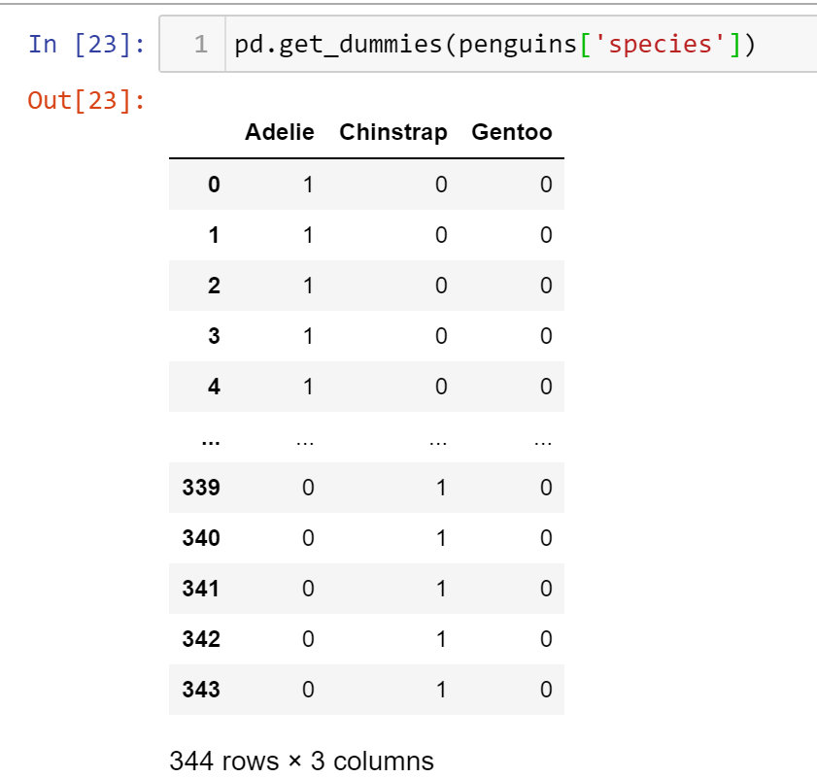

One-Hot / Dummy Encoding
Convert levels to separate integer columns.
Encode with a 1 in the level’s variable, 0 elsewhere

Slide 6
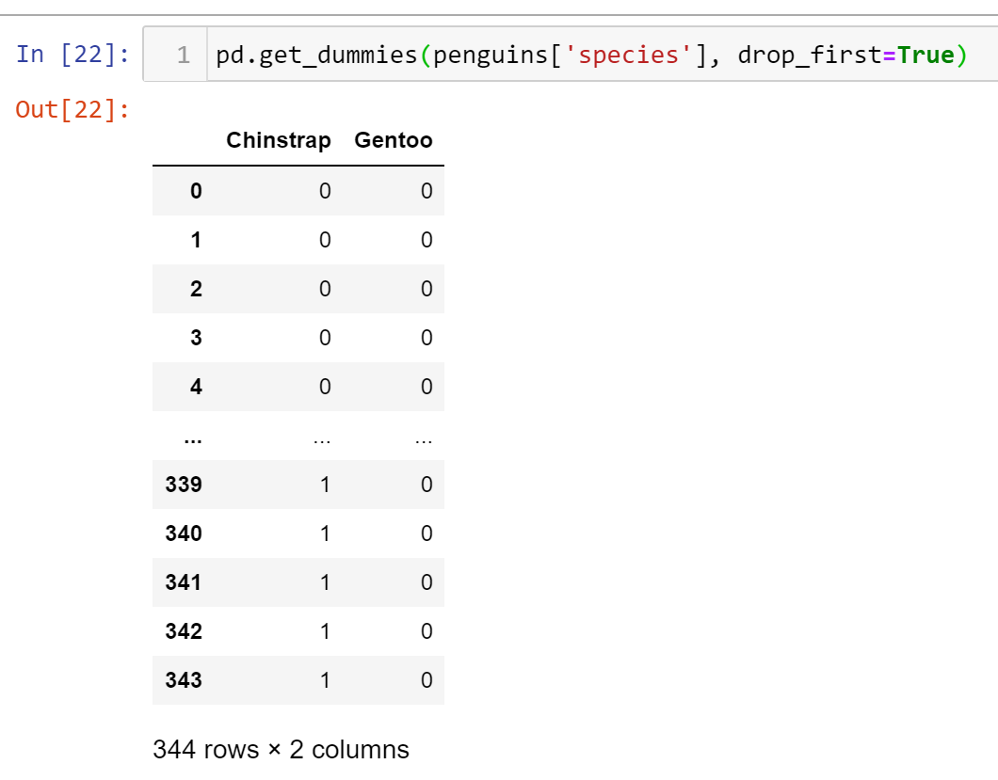

N-1 Dummy Coding
Drop one level (typically first)
All 0 encodes the dropped level
Other levels encoded with a 1 in the proper place

Slide 7
Results
Categoricals are encoded as numeric variables
Can use in models (e.g. multiply by coefficients)

Slide 8


Wrapping Up
To use categorical variables in linear models, we need to encode them numerically.
Dummy-coding converts each level into a 0/1 variable indicating whether the observation has that value of the variable.
Photo by Hamed Daram on Unsplash

